Slide 1
Chapter 12
TWO-WAY ANOVA

Slide 2
Definitions
t test
  Nominal IV, 2 levels
  Scale DV
  Independent or Paired Samples
One-way ANOVA
  Nominal IV, 3+ levels
  Scale DV
  Between-groups or Repeated-measures
Factorial ANOVA
  2+ nominal IV, each with 2+ levels
  Scale DV
  Between-groups, Repeated-measures, or Mixed design

Slide 3
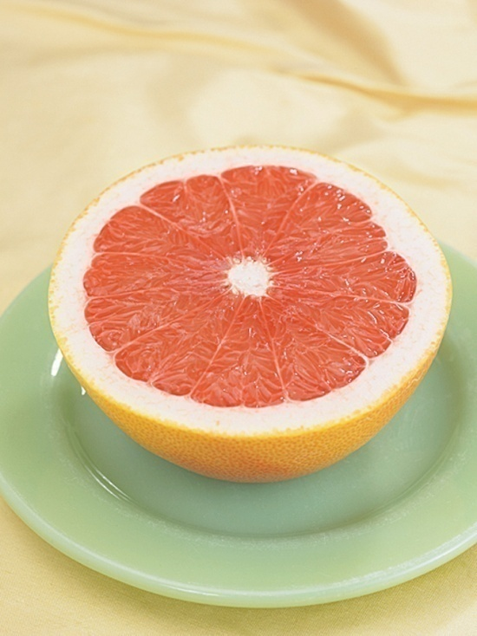
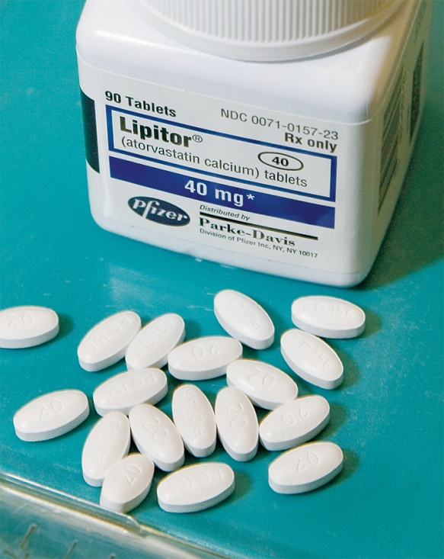
Why?
Allows us to determine effects of IVs alone
Also allows us to identify combined effects, or interactions

Slide 4
Another Example
“Your Turn” problem
  DV = score on Beck Depression Inventory (BDI)
What if you were also interested in the effect of social support on depression?
Drugs | CBT | Placebo
M = 12 | M = 11 | M = 21

Slide 5
Another Example
Two-way ANOVA
More specifically, 3 x 2 mixed design ANOVA
  Drug was manipulated within subjects
  Social Support would be a between-subjects variable
 | Drugs | CBT | Placebo
Low Social Support | M | M | M
High Social Support | M | M | M

Slide 6
Practice
(all are between-subjects designs)
Men and women worked complex problems at either 7:00 AM or 7:00 PM.
Three methods of teaching Chinese were used with 4-year-olds and 8-year-olds.
Four strains of mice were infected with three types of virus.
Four varieties of peas were grown with three amounts of fertilizer in soil of low, medium, or high acidity.

Slide 7
Practice
(all are between-subjects designs)
Men and women worked complex problems at either 7:00 AM or 7:00 PM. 2 x 2
Three methods of teaching Chinese were used with 4-year-olds and 8-year-olds. 3 x 2
Four strains of mice were infected with three types of virus. 4 x 3
Four varieties of peas were grown with three amounts of fertilizer in soil of low, medium, or high acidity. 4 x 3 x 3 (three-way ANOVA)

Slide 8
Two-way ANOVAs and the F statistic
Two-way ANOVAs produce 3 F statistics
  One for the first IV (main effect)
  One for the second IV (main effect)
  One for the interaction between the IVs
What is a main effect?
  Evaluate the main effect of one IV by discarding the influence (or ignoring) the other IV
  Similar to t test or one-way ANOVA

Slide 9

Example
Alcohol
No
Yes
No
70
60
Yes
60
20
DV: Heart rate

Slide 10
Is there a main effect of alcohol?
Alcohol
No
Yes
No
70
60
Yes
60
20
65
40
DV: Heart rate

Slide 11
Is there a main effect of sleeping pills?
Alcohol
No
Yes
No
70
60
65
Yes
60
20
40
DV: Heart rate

Slide 12
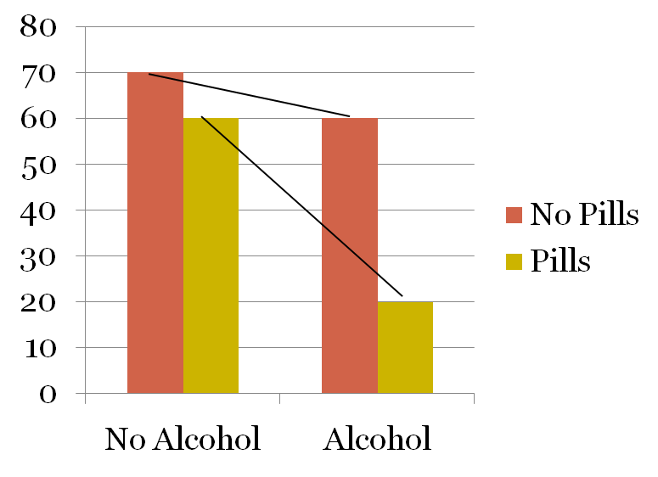
Is there an interaction?
Alcohol
No
Yes
No
70
60
Yes
60
20
DV: Heart rate

Slide 13
Quantitative Interaction
Definition: One IV exhibits a strengthening or weakening of its effect at one or more levels of the other IV, but the direction of the initial effect does not change
Alcohol alone decreases one’s heart rate but decreases heart rate even more when combined with sleeping pills

Slide 14

Example
Books read
Few
Many
Few
50
90
Many
60
100
DV: Score on vocabulary test

Slide 15
Is there a main effect for books read?
Books read
Few
Many
Few
50
90
Many
60
100
55
95
DV: Score on vocabulary test

Slide 16
Is there a main effect for books on tape?
Books read
Few
Many
Few
50
90
70
Many
60
100
80
DV: Score on vocabulary test

Slide 17
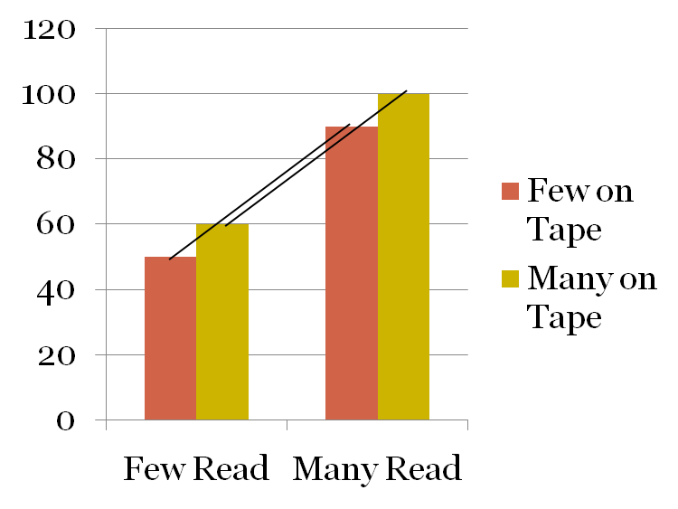
Is there an interaction?
Books read
Few
Many
Few
50
90
Many
60
100
DV: Score on vocabulary test

Slide 18

Example
Temperature
Low
High
FL
10
80
AK
80
10
DV: Comfort level

Slide 19
Is there a main effect for temperature?
Temperature
Low
High
FL
10
80
AK
80
10
45
45
DV: Comfort level

Slide 20
Is there a main effect for home state?
Temperature
Low
High
FL
10
80
45
AK
80
10
45
DV: Comfort level

Slide 21
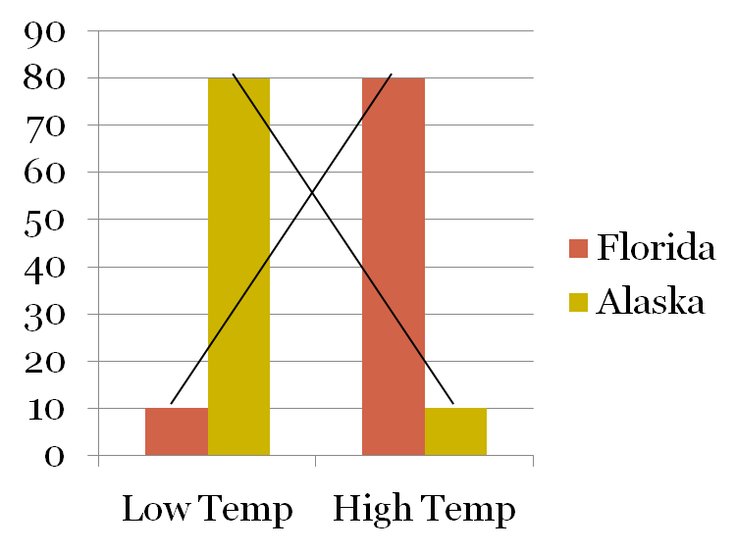
Is there an interaction?
Temperature
Low
High
FL
10
80
AK
80
10
DV: Comfort level

Slide 22
Qualitative Interaction
Definition: One IV reverses its effect depending on the level of the other IV
Temperature has opposite effects on comfort level depending on one’s home state.

Slide 23
Remember…
When there is a significant interaction, the main effects don’t tell the whole story
  Main effects can even be misleading when there is a significant interaction
The interaction typically “trumps” main effects

